Slide 1
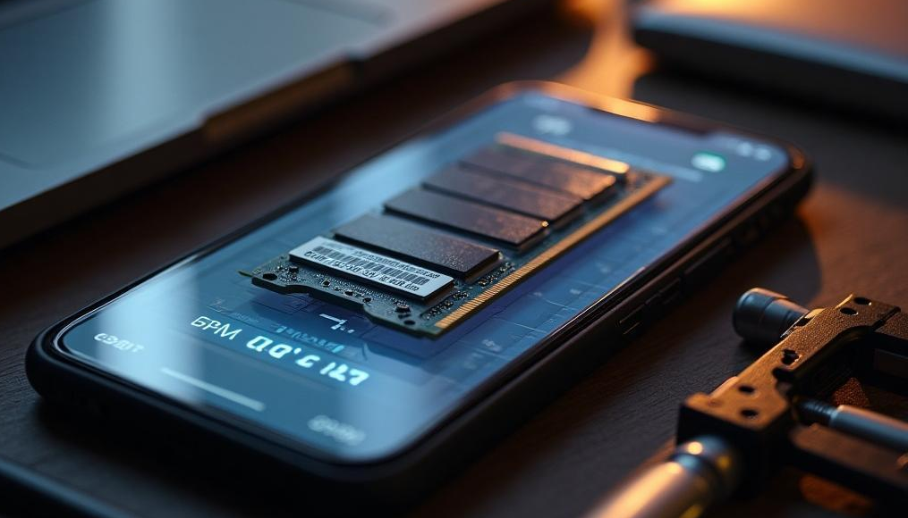
External RAM
Exploring the Role of External RAM in Enhancing Mobile Device Performance

Slide 2

Introduction
This presentation delves into the concept of External RAM, its advantages for mobile devices, and how it differs from internal RAM.

Slide 3
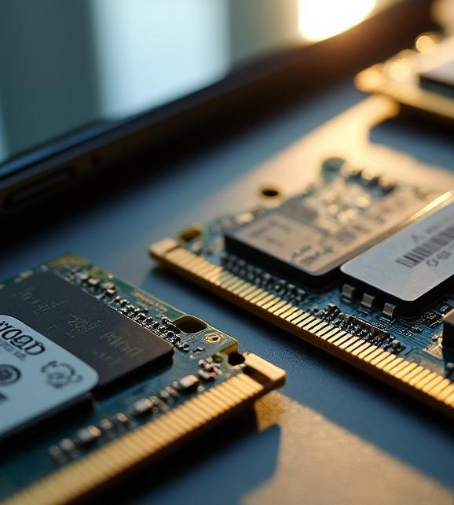
01
Overview

Slide 4

Definition of External RAM
External RAM refers to a type of memory that is not integrated within the mobile device's motherboard. It can be added or removed depending on the user's needs. This flexibility allows users to expand their device's memory capacity without relying solely on the built-in storage solutions.

Slide 5
Benefits for Mobile Devices
External RAM offers several advantages for mobile devices, including enhanced multitasking capabilities, improved performance for resource-intensive applications, and the ability to store large datasets. It allows users to run multiple applications simultaneously without lag and facilitates smooth gaming experiences.

Slide 6
Comparison with Internal RAM
External RAM and internal RAM serve the same fundamental purpose of providing memory for device operations, but they have distinct differences. Internal RAM is fixed and soldered onto the motherboard, offering faster speeds and lower latency due to its proximity to the processor. In contrast, external RAM can be expanded or upgraded based on user needs, but may experience slightly slower access times depending on the interface used. The choice between the two largely depends on specific use cases and user requirements.

Slide 7
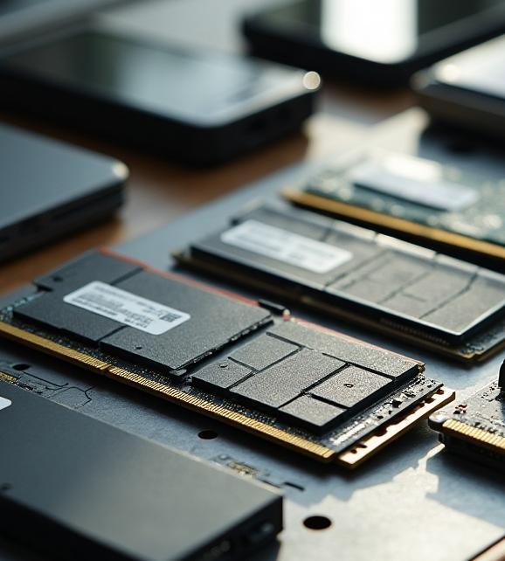
02
Implementation

Slide 8
Compatibility with Mobile Devices
When considering external RAM, users must ensure compatibility with their mobile devices. Many modern smartphones support external RAM options, but specifications vary. Device manufacturers may offer certain models with specific RAM slots or USB interfaces for external memory access. It is essential for users to consult device manuals or manufacturer websites to ascertain compatibility and avoid purchasing incompatible RAM solutions.

Slide 9
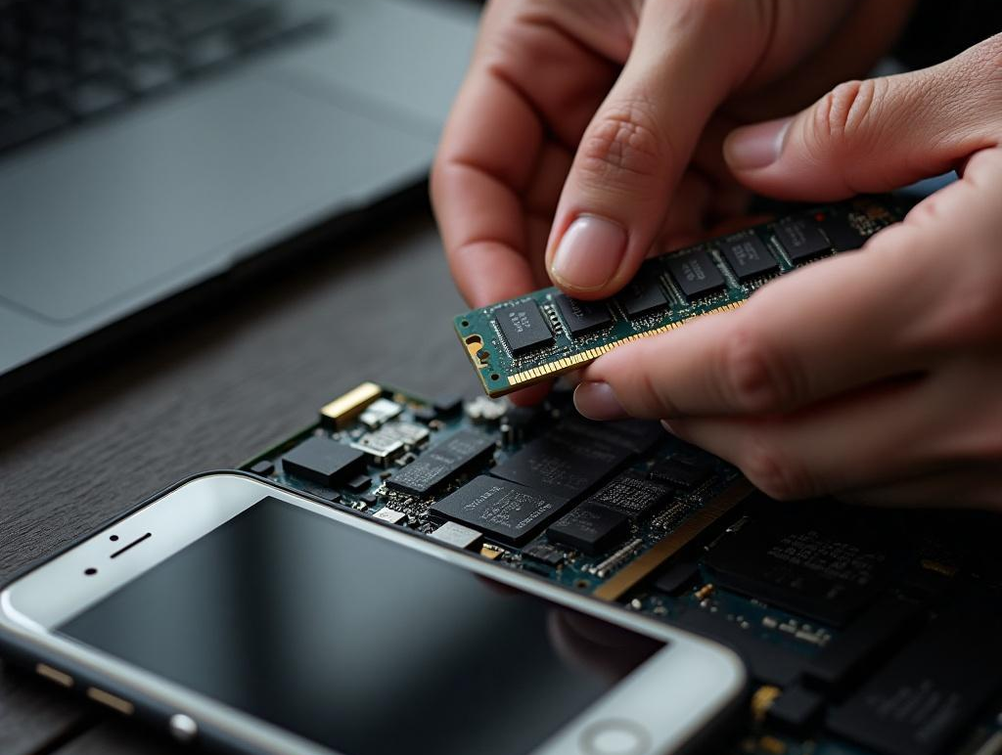
Installation Process
Installing external RAM typically involves inserting the RAM module into a designated slot or connecting it through USB or other interfaces. The process is generally straightforward, with users needing basic tools for devices that require opening. After installation, devices may require a restart to recognize the new memory. Following proper guidelines ensures that external RAM is correctly configured and functioning optimally.

Slide 10
Performance Considerations
While external RAM can enhance device performance, several factors must be considered. Speed ratings of external RAM can differ, potentially affecting performance. Users should evaluate the specifications and choose high-speed options to minimize potential bottlenecks. Additionally, devices may have limitations on the amount of external RAM they can utilize effectively, so understanding these constraints is crucial for maximizing performance.

Slide 11

Conclusions
In summary, external RAM presents a viable solution for enhancing mobile device performance by offering flexibility and increased memory capacity. However, compatibility, installation, and performance factors must be carefully considered to fully leverage its benefits.

Slide 12
Thank you!
Do you have any questions?
+91 620 421 838

